Slide 1



GLOBAL COVID -19 VACCINATION
Presenter By: Adarsh S G
Affiliation: Learn Logic AI
Date: 05-04-2025

Slide 2
INTRODUCTION
Problem Statement : To analyze the global distribution of COVID-19 vaccines,identify disparities in vaccination rates across countries,and assess the impact of vaccinations on controlling the pandemic.
2.Importance of the Problem : Help governments and organizations plan better interventions.
Role of Machine Learning in Solving It : Machine Learning enables forecasting of vaccination trends, identification of under-vaccinated regions, and pattern recognition in vaccine distribution.

Slide 3
OBJECTIVES
Clear Project Goals :
Analyze and visualize global COVID-19 vaccination data to uncover trends and disparities.
Identify factors influencing vaccination rates across different countries.
Use ML models to forecast future vaccination patterns and inform public health strategies.
Expected Outcomes :
Comprehensive understanding of global vaccination progress.
Predictive insights into future vaccination trends using ML models.
Identification of regions with low vaccination coverage needing intervention.
An interactive dashboard showcasing key metrics and visualizations for stakeholders.

Slide 4




Dataset Size & Features :
Number of Instances (Rows): 86512
Number of Features (Columns): 15
Data Type :
float64 9
object 5
datetime64[ns] 1
DATASET
Challenges :
Missing Values: Some countries have incomplete or delayed reporting
Data Imbalance: Significant disparity in vaccination rates across countries.
Data Source:
Kaggle(https://www.kaggle.com/datasets/saliblue/country-vaccinations/data

Slide 5

METHODOLOGY
Data Preprocessing Steps :
Data Cleaning and Preprocessing
Feature Engineering and Transformation
Exploratory Data Analysis (EDA)
Visualization of key insights and trends
Machine Learning Techniques Used :
Regression Models: Random Forest Regression used to predict future vaccination rates based on historical data.
Time Series Forecasting (Optional/If Applied): ARIMA or Facebook Prophet for trend prediction of vaccine rollout.
Model Selection & Evaluation: Used cross-validation and hyperparameter tuning for optimal performance.

Slide 6


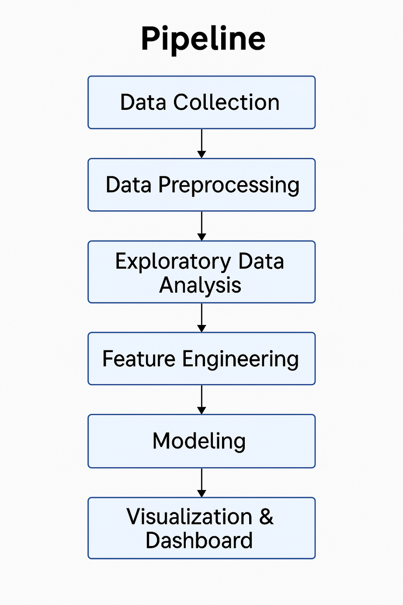




Slide 7
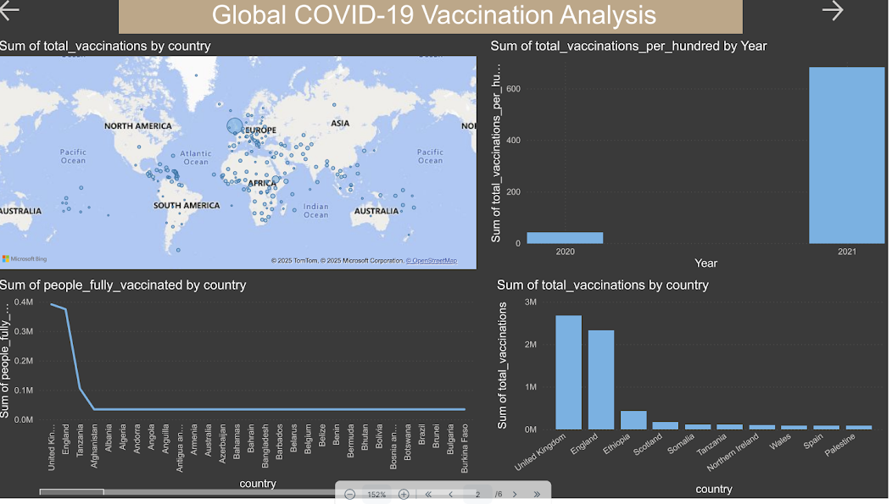
Dashboard Overview

Slide 8

Navigation & Layout Explanation
Filter Panel (Top Section)
Country, Date, ISO Code, and Vaccine Type filters allow users to explore data from different perspectives and granularities.
Main Dashboard Area
Dynamic bar charts, line charts, and maps provide visual insight into:
Total vaccinations by country
People vaccinated per hundred
Yearly and monthly trends
KPI Tiles (Top or Side Panel)
Show critical numbers like:
Total vaccinations
People fully vaccinated
Vaccinations per hundred

Slide 9
Key Insights & Analysis
Trend Analysis
Vaccination Growth Over Time: Global vaccination rates showed a sharp rise during the first half of 2021, followed by a steady climb as vaccine availability improved.
Regional Variation: Developed countries reached higher coverage faster, while lower-income countries experienced delays due to supply and infrastructure constraints.
Monthly Peaks & Dips: Clear peaks observed during large-scale campaigns; dips align with global supply chain issues and regional lockdowns.
Impact of Vaccine Type Rollouts: Rollouts of Pfizer, Moderna, and Covishield coincided with spikes in full-dose coverage.
Recent Plateauing: Many countries show a slowdown in vaccination rates as they approach saturation or face vaccine hesitancy.

Slide 10
Visual Breakdown
Explanation of Graphs & Charts:
Bar Chart - Compares total vaccinations across countries.
Pie Chart - Shows proportions of vaccine types used globally
Line Chart - Illustrates vaccination trends over time
Map – Visualizes global vaccination distribution
KPI Cards - Highlight total doses daily average and % population covered

Slide 11
Challenges & Limitations
Issues Faced During the Project :
The report highlights key challenges and disparities in global vaccination efforts:
Unequal Distribution: High-income countries achieved higher coverage, while low-income regions lagged.
Vaccine Hesitancy: Misinformation and distrust affected uptake in some populations.
Logistical Issues: Supply chain disruptions and storage limitations slowed distribution.
Access Gaps: Rural and underserved communities faced difficulties in receiving vaccines.

Slide 12
Model Limitations :
Limited feature diversity : Model performance affected by lack of socioeconomic or demographic data
Assumes data accuracy : Predictions rely on possibly outdated or inconsistent reports
Not globally generalizable : Models may not adapt well to countries with very different conditions.

Slide 13
Future Enhancements
Additional Features
Add vaccination sentiment analysis from social media/new
Track booster shots and age-wise distribution
New Datasets
Integrate hospitalization, mortality, or mobility data for deeper insights
Real-Time Application
Live dashboards with automated data refresh and user interactivity
Global Comparisons
Add benchmarking tools for country-to-country performance

Slide 14
References & Acknowledgments
Cited Sources :
Kaggle Dataset – Global COVID-19 Vaccination Data
Python Libraries: Pandas, NumPy, Matplotlib, Seaborn, Scikit-learn
Power BI for Dashboard Visualization
Research Articles and WHO Reports on COVID-19 Vaccination Trend
Acknowledgments :
Special thanks to our mentors and faculty for their guidance
Appreciation to Kaggle and global data providers
Support from team members and collaborators

Slide 15


THANK YOU

